Slide 1
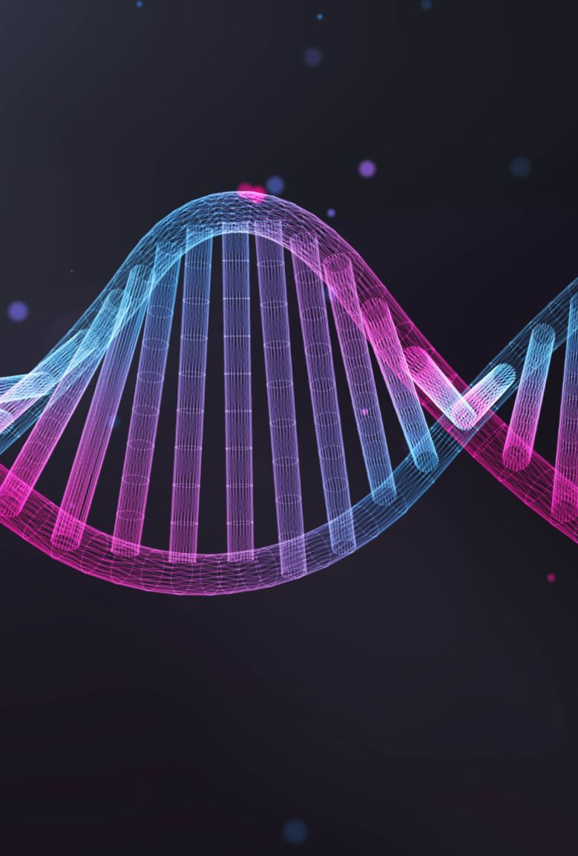
Molecular Biology & Bioinformatics
Part 1
DNA & RNA Structure & Function
Part 2
DNA replication in Prokaryotes and Eukaryotes
Part 3
Gene Expression
Part 4
Genomic Data Analysis R Programming Language(Beginning)

Slide 2
Part 1
DNA & RNA Structure & Function

Slide 3
DNA
Means Deoxyribonucleic acid
DNA – a polymer of deoxyribonucleotides
Double Stranded
Double helix Structure
Present in Chromosomes, Mitochondria and chloroplasts
It acts as Genetic material and contains Information

Slide 4
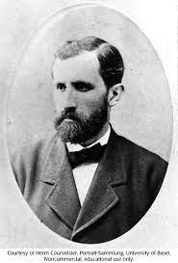
Discovery of DNA
DNA present in the Nucleus identified by Friedrich Meischer in 1968
He called ‘Nuclein’

Slide 5
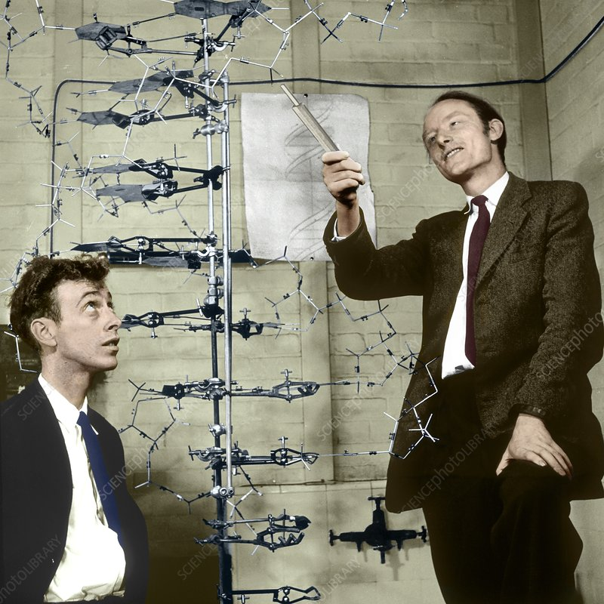
DNA
In 1953 James Watson and Francis Crick
Explained a Double Helix model for the DNA
structure of DNA

Slide 6
Scientific support
The Scientific framework and support for their research some of the other scientists are:
Linus Pauling
Rosalind Frankin and Maurice Wilkins
Erwin Chargaff

Slide 7
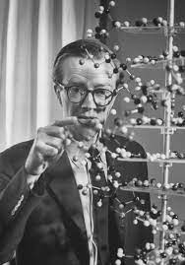
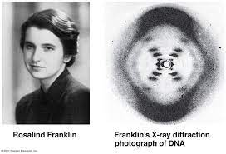
Rosalind Franklin
She jointly worked with Maurice Wilkins in the same lab
Her study X-ray diffraction to study wet fibres of DNA
She marked advances in X-ray diffraction
Technologies with DNA
Diffraction Pattern obtained several structures
and some features of DNA
Helical
More than 1 strand
10 Base pairs per complete turn

Slide 8
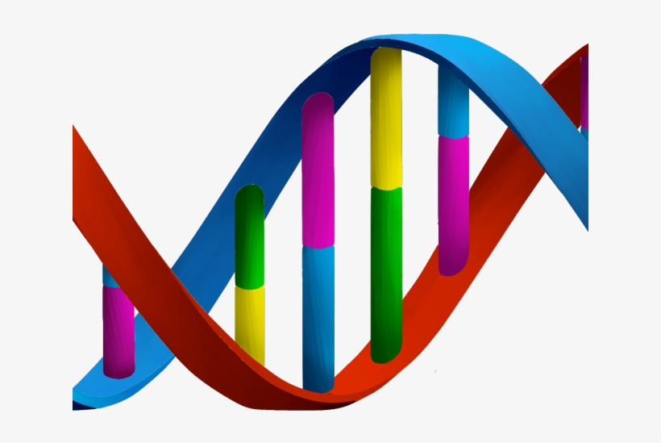
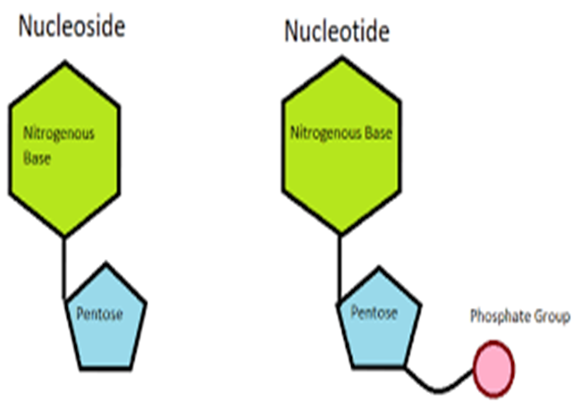
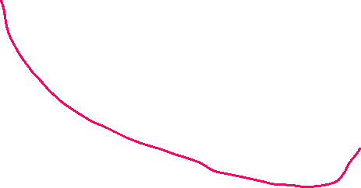
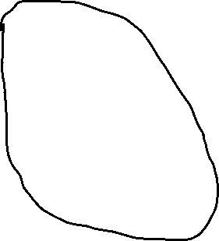




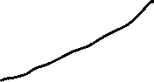
DNA Structure
DNA structure is divided into 4 different levels primary, secondary, tertiary and quaternary
DNA has 3 main basic components
1. Deoxyribose(Pentose Sugar)
2. Nitogenous Base(there are 5)
3. Phosphate

Slide 9




Nucleotide & Nucleoside
DNA RNA
Poly Nucleotides
Nucleotide-> Sugar + Base + Phosphoric Acid
Nucleoside + Phosphoric Acid
(Phosphoric acid ester of nucleoside)
Nucleotides

Slide 10
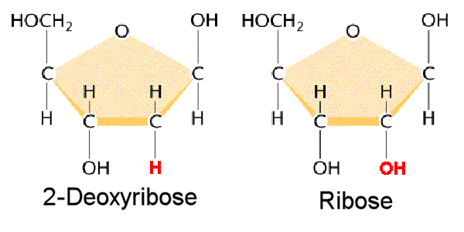
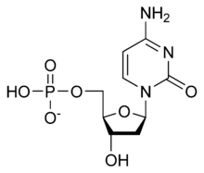
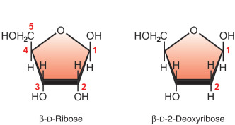


Sugar(pentose)
DNA
RNA

Slide 11
Nitrogenous Bases
They are divided into 2 groups
1. Pyrimidines
2. Purines
Pyrimidines (Contain 6 member ring)
Thymine
Cytosine
Uracil ----- in case of RNA
Purines(6 + fused with 5 member ring)
Adenine
Guanine

Slide 12
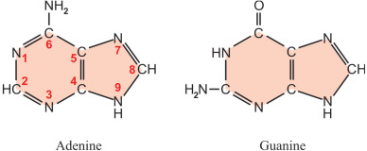
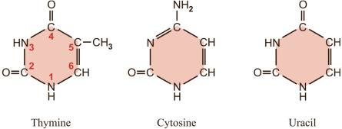
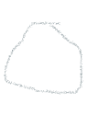




Nitrogenous Bases of DNA & RNA

Slide 13
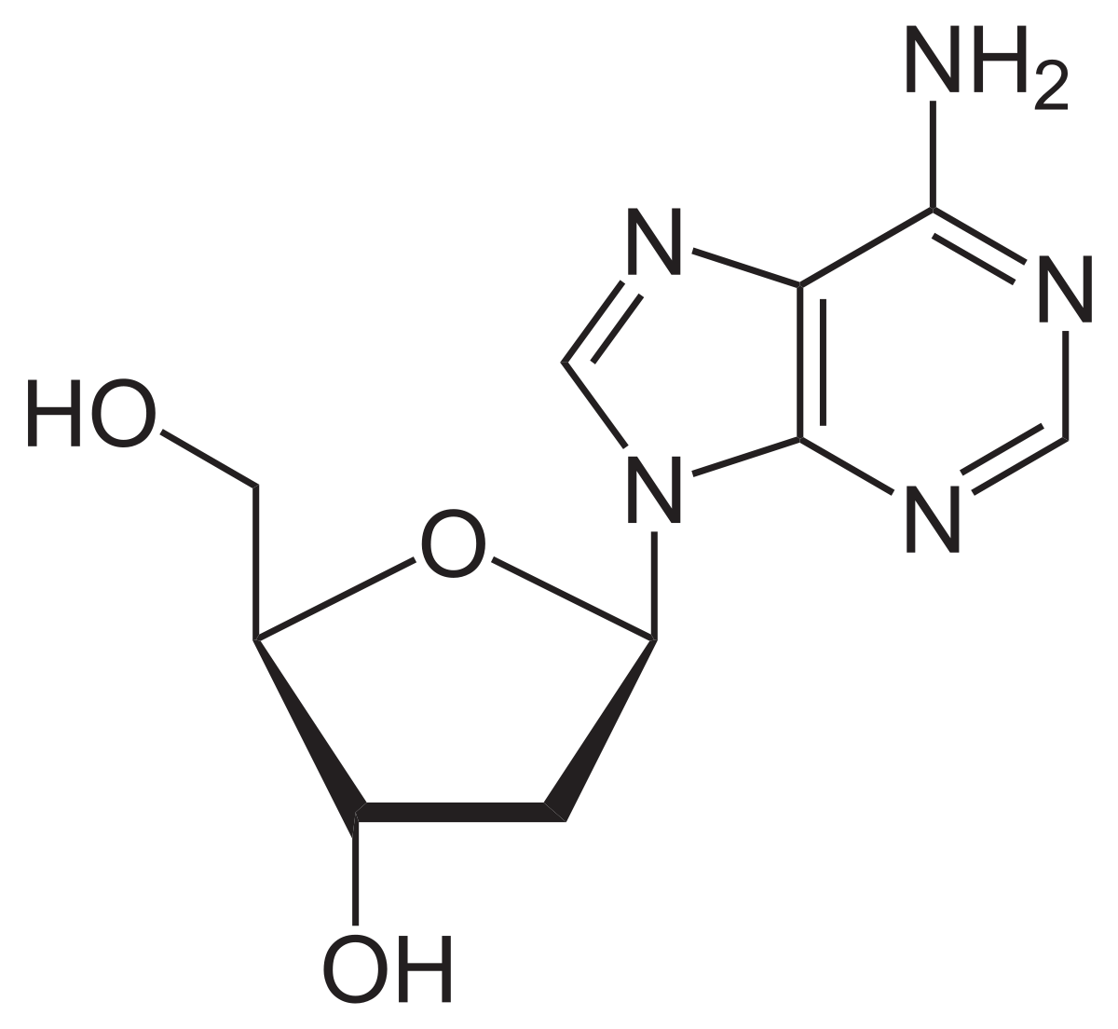
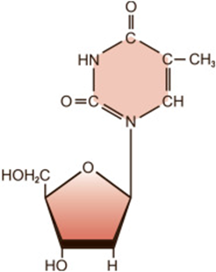
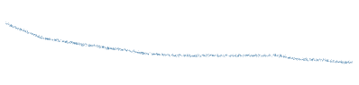

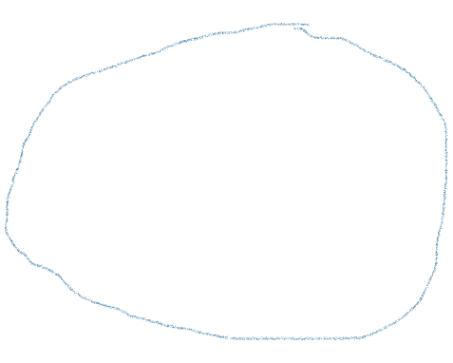

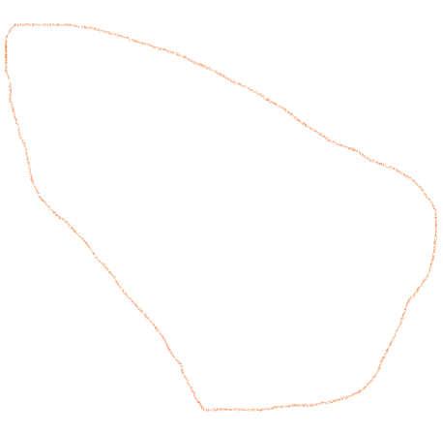

Structure of Nucleoside
Purine
Nucleoside = Sugar + Base
Adenine
Pyrimidine
Deoxyribosethymine
Deoxyribose
Deoxyriboadenosine

Slide 14
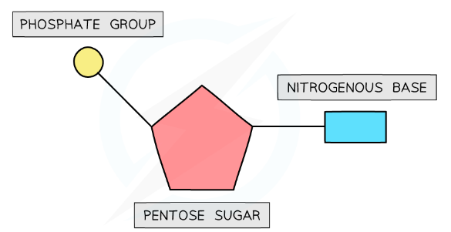
Nucleotide Structure
Nucleotides are formed by the condensation of sugar, phosphate and one of the 4 bases
The below represents the nucleotide structure

Slide 15
Nucleotides
Base + Sugar → Nucleotide
Ex –
Adenine +ribose = Adenosine
Adenine +deoxyribose = Deoxyadenosine
Base +Sugar +phosphate -> Nucleotide
Ex –
Deoxyadenosine monophosphate (dAMP)
Deoxyadenosine diphosphate (dADP)
Deoxyadenosine triphosphate (dAtP)

Slide 16
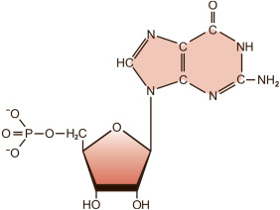
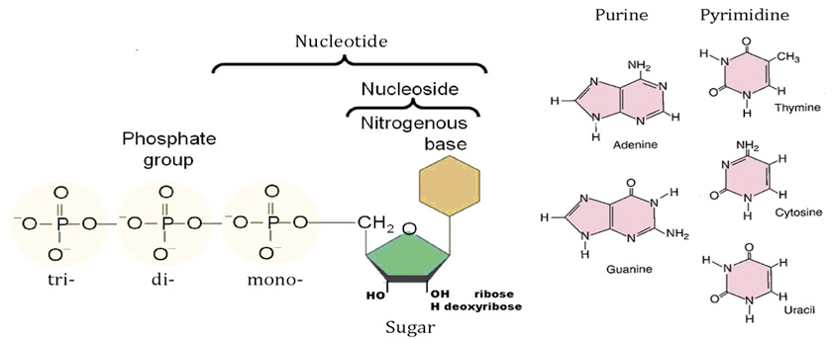


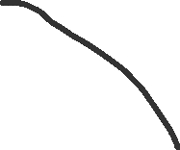
Nucleotide = Nucleoside + Phosphate Group
Phosphates are attached here at 5’
Bases are attached here at 1’

Slide 17
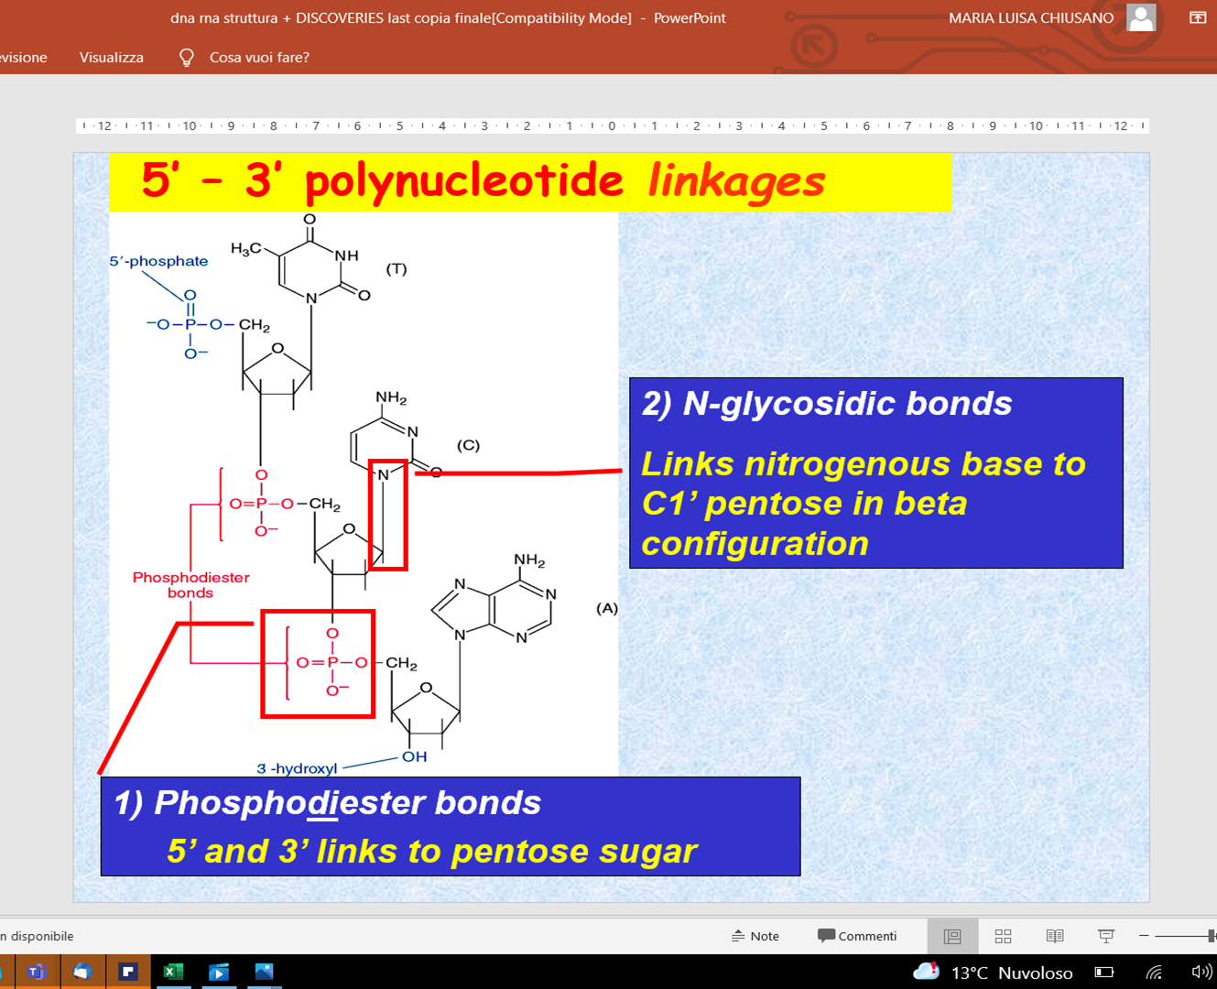
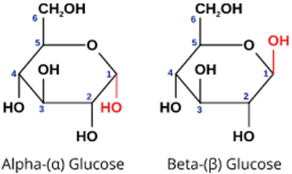
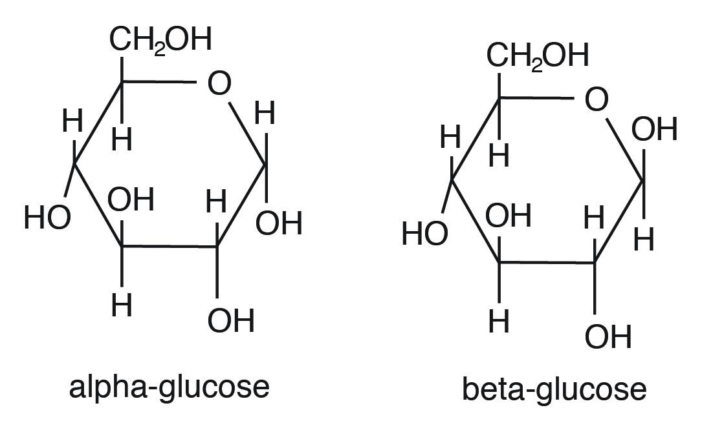


Nucleotides are linked together by covalent bonds called phosphodiester linkage
Covalent Bond That involves sharing of a pair of electrons between atoms in a molecule

Slide 18
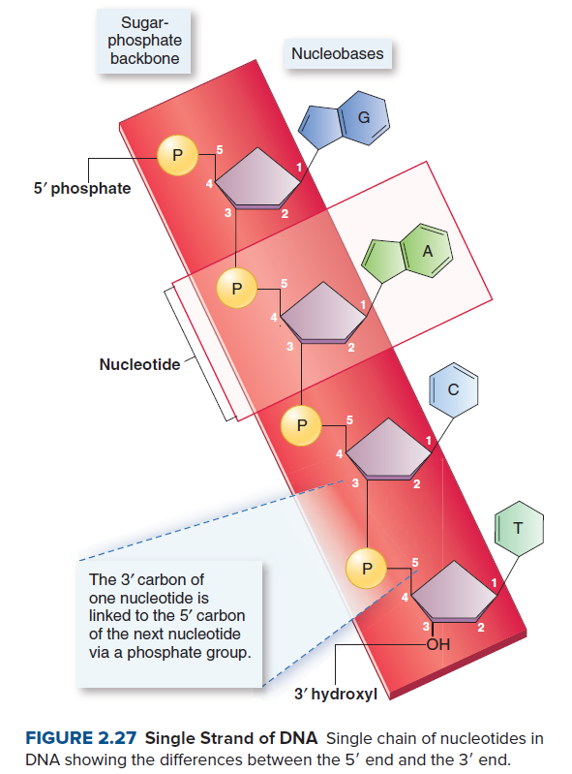
Backbone

Slide 19
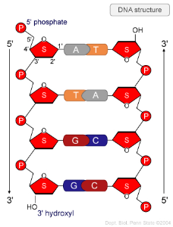
DNA double helix & hydrogen Bonding
Features of Double helix Structure of DNA
It is made up of two polynucleotide chains where the backbone is constituted by sugar-phosphate and bases are inwards
The 2 chains have anti-parallel, which means the chain has
5’->3’ other has 3’-> 5’

Slide 20
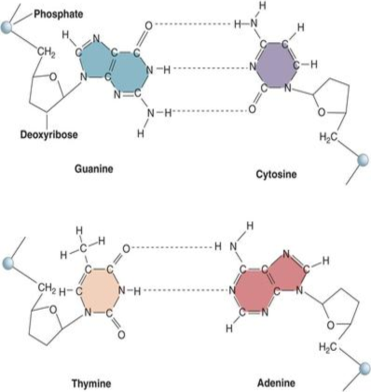
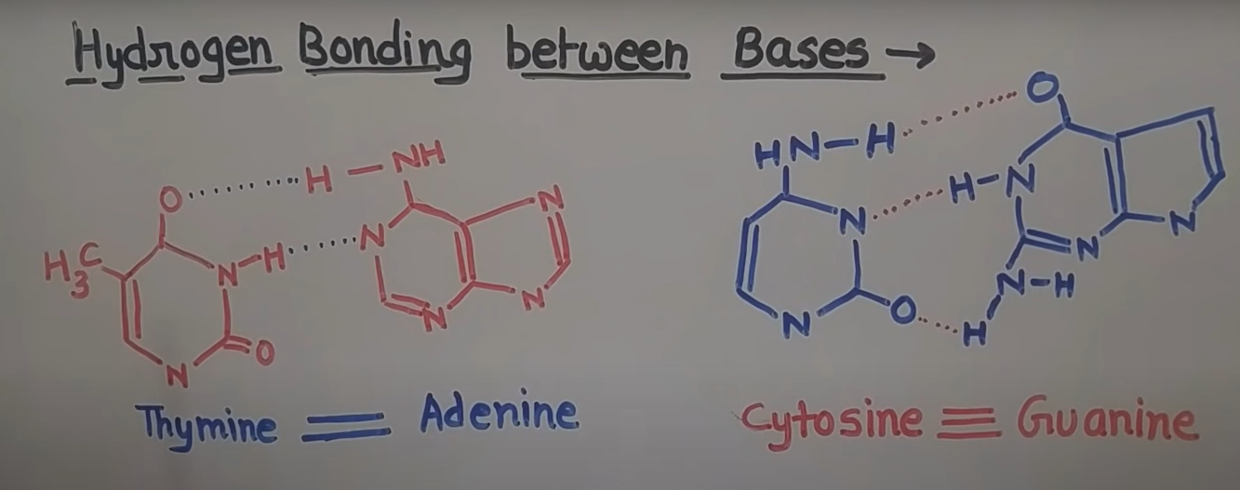
DNA hydrogen Bonding
Bases of two strands are paired up with hydrogen bond (H-bond) forming base pairs. Adenine 2HB with Thymine, similarly Guanine 3HB with Cytosine
It is observed by Erwin Chargaff in DNA Adenine with Thymine and Guanine with Cytosine are constant and equal
Hydrogen bond – A chemical bond consisting of a hydrogen atom between 2 electronegative atoms (in this example – oxygen and nitrogen) is one side covalent bond and another side ionic bond

Slide 21
Erwin Chargaff’s Experiment
We already know that DNA contained 4 bases ATGC
Chargaff analysed the base composition of DNA isolated from many different species
Final Hypothesis
Analysis of the base composition of DNA in different species which proves the structure of DNA composition

Slide 22
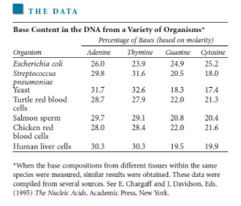
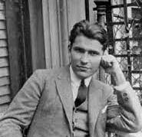
Source of Data
Based on observation of data
% of Adenine = % of Thymine
% of Cytosine = % of Guanine
Its called Chargaff’s Observation Rule

Slide 23
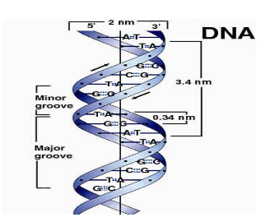
Pitch and Base pair of DNA helix
The 2 strands are coiled in a right-handed fashion(Clockwise)
The pitch of the helix is 3.4nm(nm in 1 billion of meter)
There are 10bp in each turn
The distance between a bp in a helix is approximately 0.34nm

Slide 24
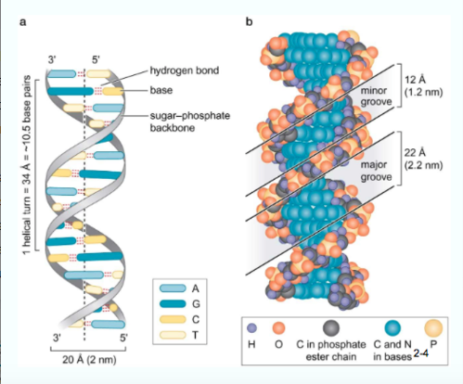
Groove in DNA
There are 2 asymmetrical grooves on the outside of helix
Major Groove
Minor Groove
Groove - a long, narrow cut or depression in material or channel on a bodily structure or part

Slide 25
Structure of Double Helix
There are 3 forms
B-DNA
A-DNA
Z-DNA

Slide 26
B-DNA
It is the Most common DNA
It is Alpha-helix and it has a right-handed or clockwise direction
It is a complementary base pairing
A-T
G-C
It has 10 base pair units per 1 turn(360-degree rotation of helix)
Then each Base is twisted 36 degree same to adjacent bases
Base pair are 0.34nm apart
Complete rotation of molecule is 3.4nm

Slide 27
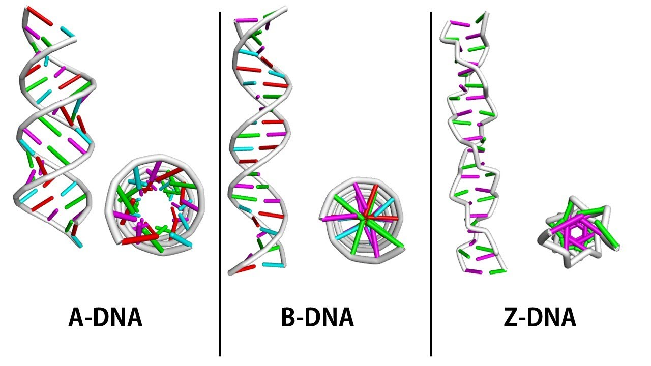
B-DNA
Minor Groove is Narrow, Swallow
Major Groove is Wide, Deep
This structure exists when plenty of water surrounds the molecule
B-DNA structure is the most stable configuration for a random sequence of nucleotides
Axis is exactly passed through the centre of each bp

Slide 28
A-DNA
It is Right Handed helix
Wider and flatter than B-DNA
11bp per turn
Bases are fitted from the main axis of the molecule
Narrow Deep major Groove and Broad, Swallow in minor Groove
Observed when less water is present means (dehydrating condition)
Present or observed in DNA Polymerase

Slide 29
Z-DNA
Left-handed helix
Presence in high Salt Condition
Sugar phosphate backbone in zigzag backbone so it is called Z-DNA
12 bp per turn
Deep minor Groove
No Discernible Major Groove(able to be seen, recognized, or understood)
Role presence in Gene Expression

Slide 30
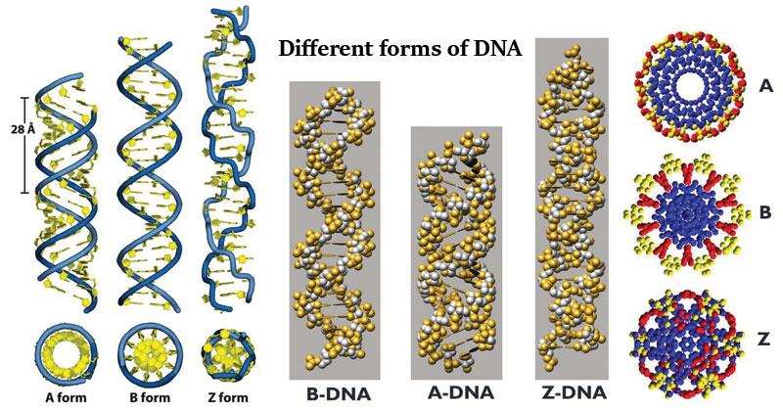

Slide 31
Difference between B A Z DNA
Property | B-DNA | A-DNA | Z-DNA
Strand | Antiparallel | Antiparallel | Antiparallel
Type of Helix | Left handed | Right handed | Left handed
Overall of Shape | Long and Narrow | Short and Wide | Elongated and Narrow
Base per unit Turn | 10 | 11 | 12
Distance b/w adjacent bases | 0.34nm | 0.23nm | 0.38nm
Pitch/turn of helix | 3.4nm | 2.82nm | 4.5nm
Helical diameter | 2.0nm | 2.3nm | 1.8nm
Tilt/Inclination of bp to axis | 1 degree | 20 degree | 9 degree
Major Groove | Wide & Deep | Narrow & Deep | No Discernible
Minor Groove | Narrow, Shallow | Broad, Shallow | Narrow, Deep

Slide 32
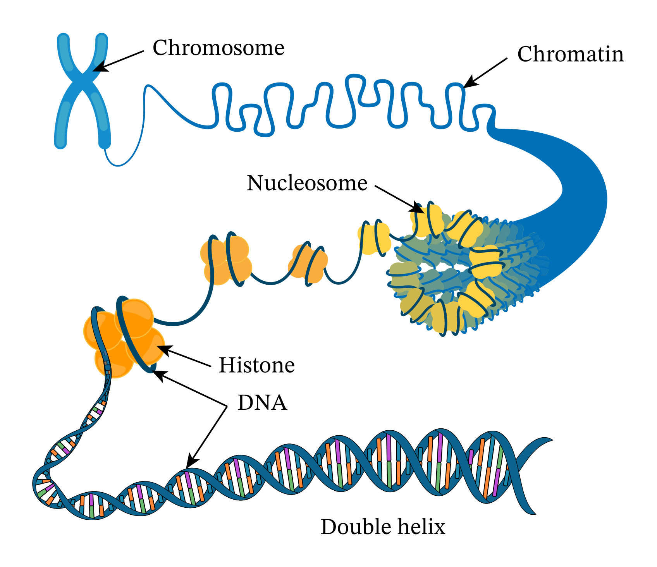
DNA Coiling
Each Chromatid
700n in diameter
Radial loops
(300nm in diameter)
DNA supercoiling means under winding of strands
DNA coiling is important for DNA packaging within cells
Coiling of DNA which reduces the space and allows for much more DNA to Pack
Radial loops
(11nm in diameter)
DNA wounded around Histone protein

Slide 33
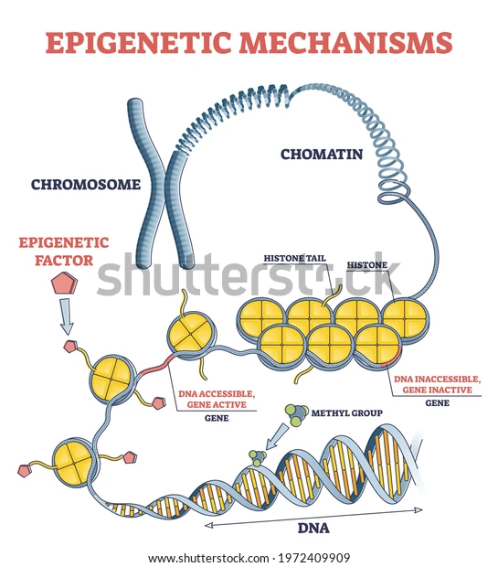
coil

Slide 34
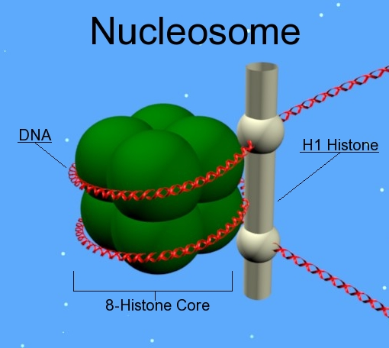

Nucleosome Structure
Nucleosome are the basic unit of chromatin organization.
In Eukaryotes DNA associated with Proteins
In prokaryotes DNA is Visible or naked
Nucleosomes are Basic bread like Units of DNA packing
- -made up of a segment of DNA wound around a protein core that is composed of 2 copies of each 4 types of Histones
Nucleosomes have :
8 Histones in the core
DNA wrapped twice around the core
1 Histone is holding the Nucleosome together
DNA like continues towards the next nucleosome
DNA is –vely charged (because of phosphate group)
Protein is +vely charged(means Histone)
DNA and Protein are electromagnetically attached to each other to form chromatin

Slide 35
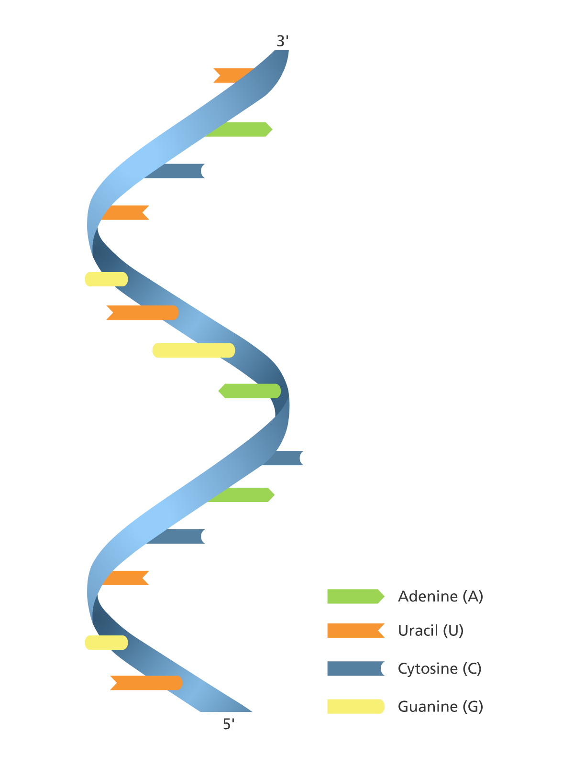
RNA Ribonucleic Acid

Slide 36
RNA
Means Ribonucleic Acid
RNA is a polymer of ribonucleotides linked together by a phosphodiester linkage
RNA was the first genetic material
In 1967 Carl Woese found the catalytic properties of RNA which carry genetic information and catalyse biochemical reactions
It is not valid until the work by N-Prize Thomas R Cech. In 1970 he studied RNA splicing. Later some research & discovered that unprocessed RNA molecules could splice themselves. In 1982 discovery and he announced RNA has a catalytic function(Catalysis is the process of increasing the rate of a chemical reaction by adding a substance known as a catalyst)
It is a single-stranded and helical Structure
Double stranded also present in some viruses(https://www.sciencedirect.com/topics/medicine-and-dentistry/double-stranded-rna-virus)

Slide 37
Cont,
RNA is present in several different single-stranded structures, most of which are directly or indirectly involved in protein synthesis or regulation
It also acts as genetic material
It function as Messenger(mRNA), adapter(tRNA), structural(rRNA) and in some cases as a catalytic molecule(Ribosome)
RNA strands are typically several hundred to thousand nucleotides in length

Slide 38
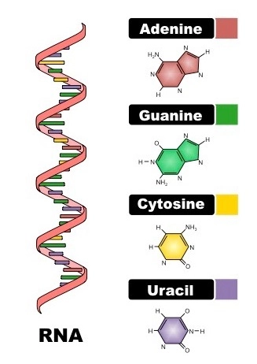
RNA Structure
There are 3 components in RNA
Phosphate Group
Sugar(ribose)
Nitrogenous Base
Nitrogenous Bases:
There are 2 Groups
Purine
Pyridimine
Purine : It is 6 member ring combine with 5 member ring
1. Adenine
2. Guanine
Pyrimidine : it is 6 member ring
1. Cytosine
2. Uracil

Slide 39
Nucleotide Structure in RNA
Nucleotides are formed by the condensation of sugar, phosphate and one of the 4 bases
The below represents the nucleotide structure
A, G, C or U is present
Ribose

Slide 40
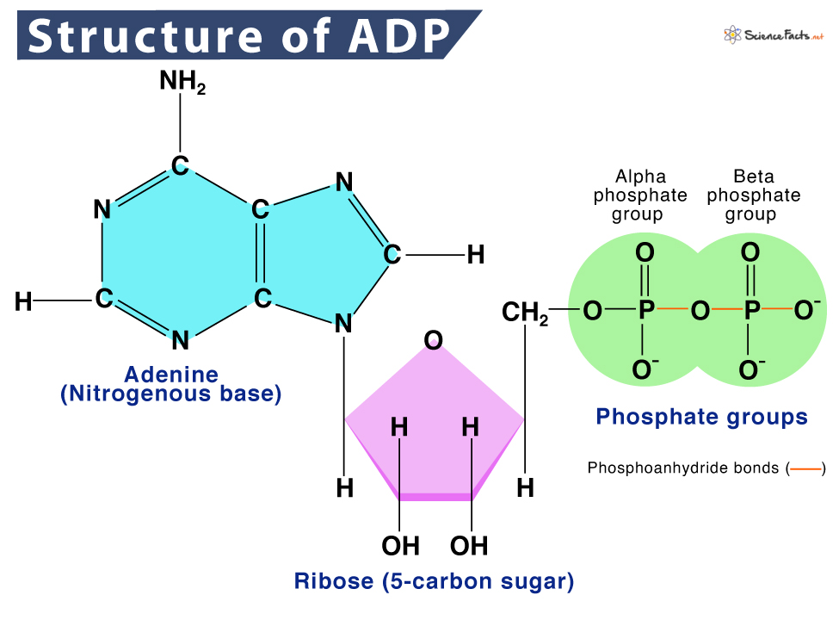



What is alpha phosphate group? The phosphate group closest to the ribose sugar is called the alpha phosphate group
Base + Sugar → Nucleotide
Ex –
Adenine +ribose = Adenosine
Adenine +deoxyribose = Deoxyadenosine
Base +Sugar +phosphate -> Nucleotide
Ex –
Adenosine monophosphate (AMP)
Adenosine diphosphate (ADP)
Adenosine triphosphate (ATP)

Slide 41
dsRNA(Double-stranded RNA) STructure
There are Double stranded RNA Structures
RNA can fold back on itself
Depends on the base sequence
Gives stem(double strand) and Loop(Single strand Structure)
dsRNA has A-like conformation
if steric clashes between 2’OH groups prevent the B-like confirmation
Stem loop consists of a stem, double helix, and a loop which links the stem

Slide 42
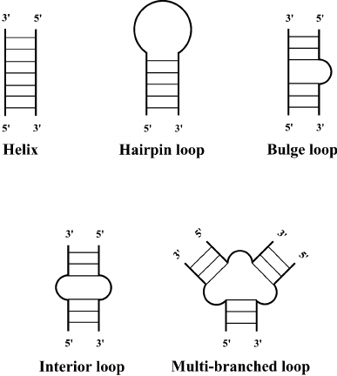

Slide 43
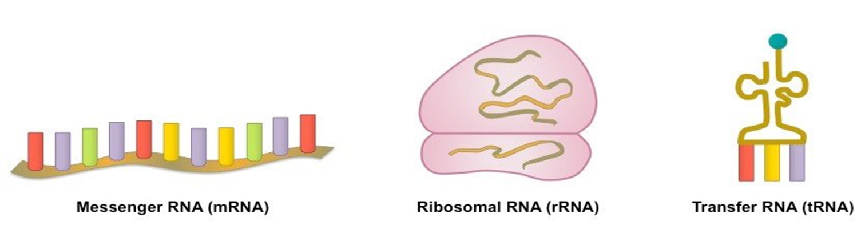
Types of RNA
In both Pro and Eukaryotes 3 main classes of RNA molecules exist:
Messenger RNA(mRNA)
Transfer RNA(tRNA)
Ribosomal RNA(rRNA)
Some of the others are:
Small nuclear RNA(snRNA)
Micro RNA(miRNA)
Small interfering RNA(siRNA)
Heterogeneous nuclear RNA(hnRNA)

Slide 44
FUNCTIONS OF RNA
RNA is a nucleic acid messenger between DNA and ribosomes.
It serves as the genetic material in some organisms (viruses).
Some RNA molecules play an active role within cells by catalyzing biological reactions, controlling gene expression, or sensing and communicating responses to cellular signals.
Messenger RNA (mRNA) copies DNA in the nucleus and carries the info to the ribosomes (in cytoplasm).
Ribosomal RNA (rRNA) makes up a large part of the ribosome; reads and decodes mRNA.
Transfer RNA (tRNA) carries amino acids to the ribosome where they are joined to form proteins.
Certain RNAs are able to catalyse chemical reactions such as cutting and ligating other RNA molecules, and the catalysis of peptide bond formation in the ribosome; these are known as ribozymes.

Slide 45
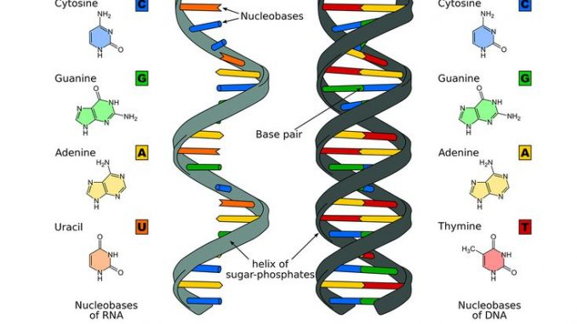
RNA v/s DNA

Slide 46
Difference
S.N. | Ribonucleic acid (RNA) | Deoxyribonucleic acid (DNA)
1. | It contains ribose sugar. | It contains deoxyribose sugar.
2. | It lacks Thymine but has Uracil. | It lacks Uracil but has Thymine.
3. | It is a single chain of polynucleotides. | It is a double chain of polynucleotides.
4. | The quantity of RNA varies in different cells. | The quantity of DNA is fixed in each cell of a species, except gametes.
5. | It mainly occurs in the cytoplasm with small quantity found in the nucleus. | It mainly occurs in the nucleus with small quantity found in mitochondria and plastids.
6. | It is formed by DNA and cannot replicate itself. | It can replicate itself.
7. | RNA is the main component of ribosomes. | DNA is the main component of chromosomes.
8. | It guides protein synthesis and also guides the replication process. | It controls structure, metabolism, differentiation, heredity and evolution.
9. | It is of 3 main types; mRNA (messenger RNA), tRNA (transfer RNA) and rRNA (ribosomal RNA). | It is of 2 types; linear intranuclear and circular extranuclear.
10. | RNA molecule is relatively short (70-12000 nucleotides) and has a relatively low molecular weight. | DNA molecule is very long (millions of nucleotide pairs) and the molecular weight is very high.
11. | No primer is needed for the transcription of RNA. | A primer is needed for the replication of DNA.
12. | It is hydrolyzed by the enzyme RNase (ribonuclease). | It is hydrolyzed by the enzyme DNase (deoxyribonuclease).
13. | The mRNA translates its information into polypeptides. | DNA transcribes its genetic information to mRNA.
14. | RNA doesn’t show helical coiling. | DNA shows a double helical coiled structure.
15. | It is genetic material in certain viruses. | It is a genetic material in all organisms.

